Slide 1



DATA ANALYSIS USING PYTHON
https://rb.gy/h59wp

Slide 2
IMPORTING DATA
Before we start analyzing data, we need to import it into our Python environment. One of the most popular libraries for handing data is pandas. With just a few lines of code , we can read data from various sources, such as CSV files, Excel files, and databases.
Import pandas as pd
# Read data from a CSV files
Data = pd . read_csv (‘data.csv’)
https://rb.gy/h59wp

Slide 3
EXPLORING DATA
Before we dive deep into analysis , it’s essential to get a sense of the data’s structure and distribution . Pandas allow us to inspect the first few rows and generate summary statistics quickly. Understanding the data’s basic characteristics will help us make better decision during analysis.
# Display first few rows
Print(data . Head () )
# Summary statistics
Print ( data . Describe () )
https://rb.gy/h59wp

Slide 4
DATA CLEANING
Messy data can be a headache for analysis . But worry not, we’ve got you covered. Data cleaning is a step to ensure the accuracy of our insights. We’ll check for missing values and remove or fill them appropriately . By the end of this step, our data will be pristine and ready for analysis .
# Removing duplicates
df = df .drop_duplicates ()
#Handling missing values
Df = df .dropna() #Remove rows with any NaN
Df = df .fillna(0) # Replace NaN with 0
https://rb.gy/h59wp

Slide 5
DATA VISUALIZATION
The say a picture is worth a thousand words, and that holds true for data analysis . Visualizations can uncover pattern and trends that might be hidden in row number. We’ll use Matplotlip and Seaborn libraries to create various plots. Such as scatter plots, bar plots, and heatmaps.
Import matplotlib. Pyplot as plt
Import seaborn as sns
# Create a scatter plot
Plt . figure( figsize= ( 8,6 )
Sns . Scatterplot (x=‘age’ , y= ‘income’ , data= data_cleaned)
Plt.title ( ‘Age’ , vs income’ )
Plt.xlabel (‘Age’)
Plt.ylabel (‘Income’)
Plt.show()
https://rb.gy/h59wp

Slide 6
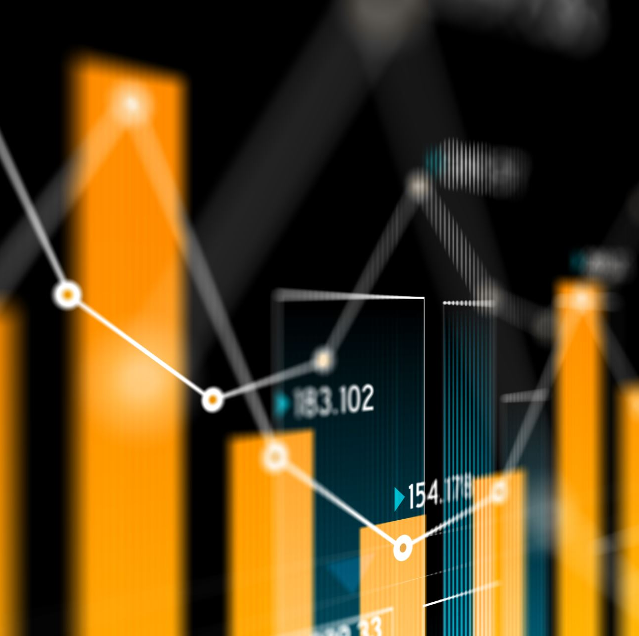
DATA ANALYSIS – CORRELATION
Now that we have our data cleaning and visualized . It’s time to dive deeper into relationship between variables. Correlation analysis helps us identify which features are positively or negatively related. We’ll visualize the correlation matrix as a heatmap to gain better insights into these connections.
# Calculate correlation matrix
correlation_matrix = data_cleaned . Corr()
# Plot a heatmap
Plt. Figure (figsize = (10, 8 )
Sns . Heatmap (correlation_matrix , annot = True, cmap = ‘coolwarm’ )
Plt. Title (‘Correlation Heatmap’ )
Plt.show()

Slide 7
DATA ANALYSIS – GROUPING AND AGGREGATION
Grouping data allows us to explore pattern and trend across different categories. We’ll group our based on specific feature , such as gender, and then perform aggregate functions like calculating the mean, median or count. This way , we can uncover valuable insights based on different segments of the data .
# Grouping a gender and calculate mean income
grouped_data = data_cleaned.groupby(‘gender’) [‘income’].mean()
# Create a bar plot
Plt . figure( figsize= ( 8,6 )
Sns . barplot (x=grouped_data.index, y= grouped_data.values )
Plt.title ( ‘Average Income by Gender’ )
Plt.xlabel (‘Gender’)
Plt.ylabel (‘ Average Income’)
Plt.show()
https://rb.gy/h59wp

Slide 8
Thank You ……
https://rb.gy/h59wp

